Slide 1
FOOD RECIPE
By SL SG GROUP-4

Slide 2
Team Members
Employee ID | Employee Name | Role
2492692 | Patan Mehataj | Team Lead
2492241 | Kurba Gorrela Ravikrishna | Back-End Lead
2491636 | Kurma Narsimlu
2492824 | Manoj Atmaram Parab
2491958 | Monalisa Rout
2491157 | Munagapati Chandana sai | Front-End Lead
2492771 | Nandana B N
2490933 | Palachuru Bhanu Prakash
2492640 | Pankaj Kishor Masaye
2492203 | Pichika Bala Veera Ganapathi | Testing

Slide 3
INDEX
Introduction
Project Scope
Tools & Technologies
User Module
Admin Module
Conclusion

Slide 4
Introduction
Cooking client is a food recipe website that has capability to showcase recipes.
It is a one stop place to upload and view some mouthwatering recipes.
This website helps genuine foodlovers to explore and have wonderful experience with the recipes uploaded.

Slide 5
Technologies Used
Front –End: Angular
Server-side: Sping Boot
Backe-end:MYSQL, Hibernate
Server:TOMCAT

Slide 6
User Module
Registration
Login
Search Recipe
logout

Slide 7
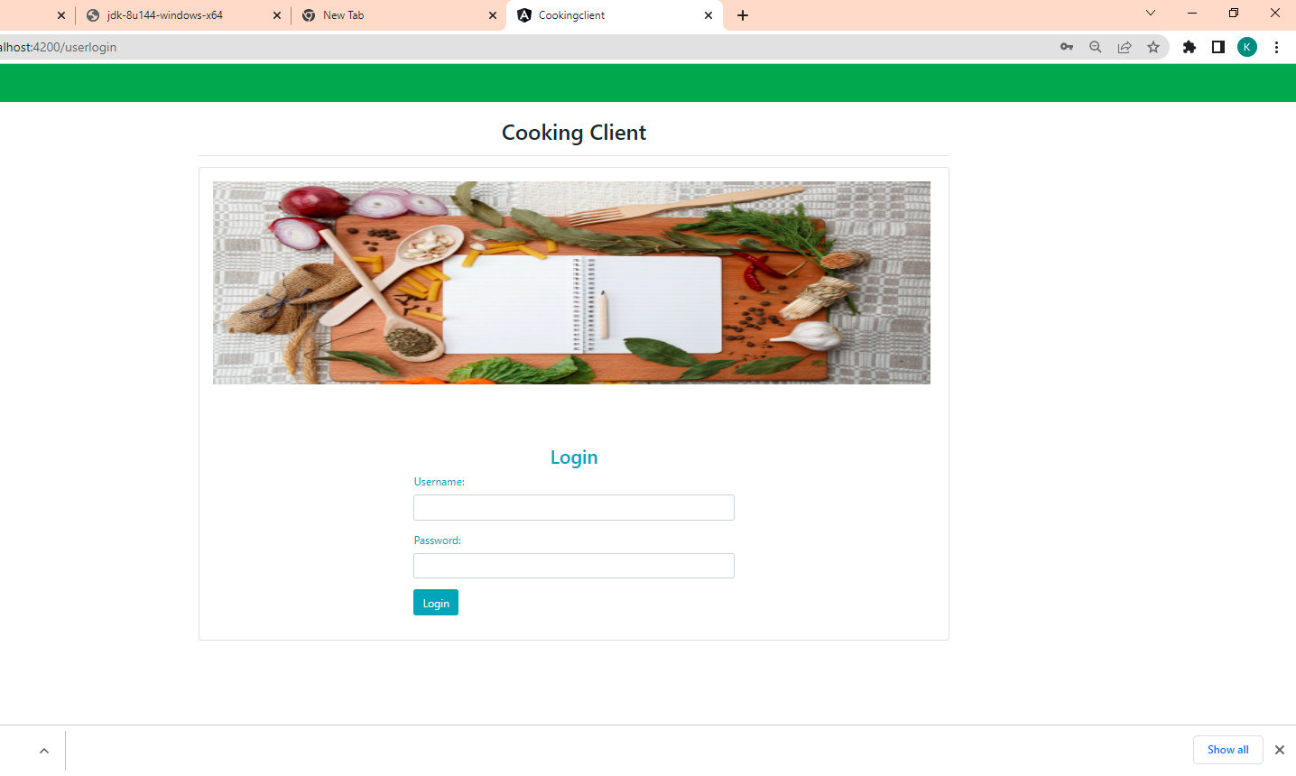
LOGIN MODULE
Fields Required:
1.User name
2.Password

Slide 8
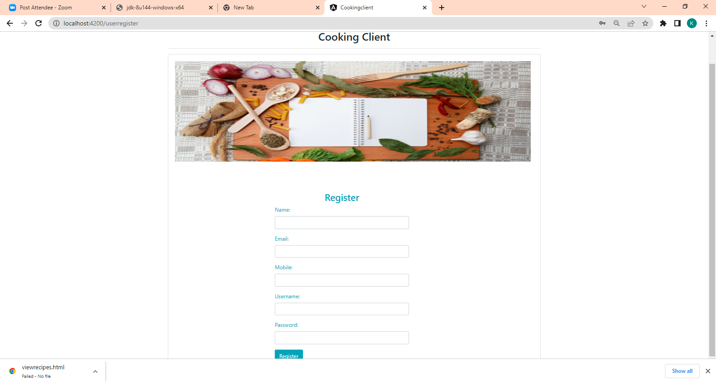
USER REGISTRATION MODULE
Fields Required
Name
Email
Username
Password

Slide 9
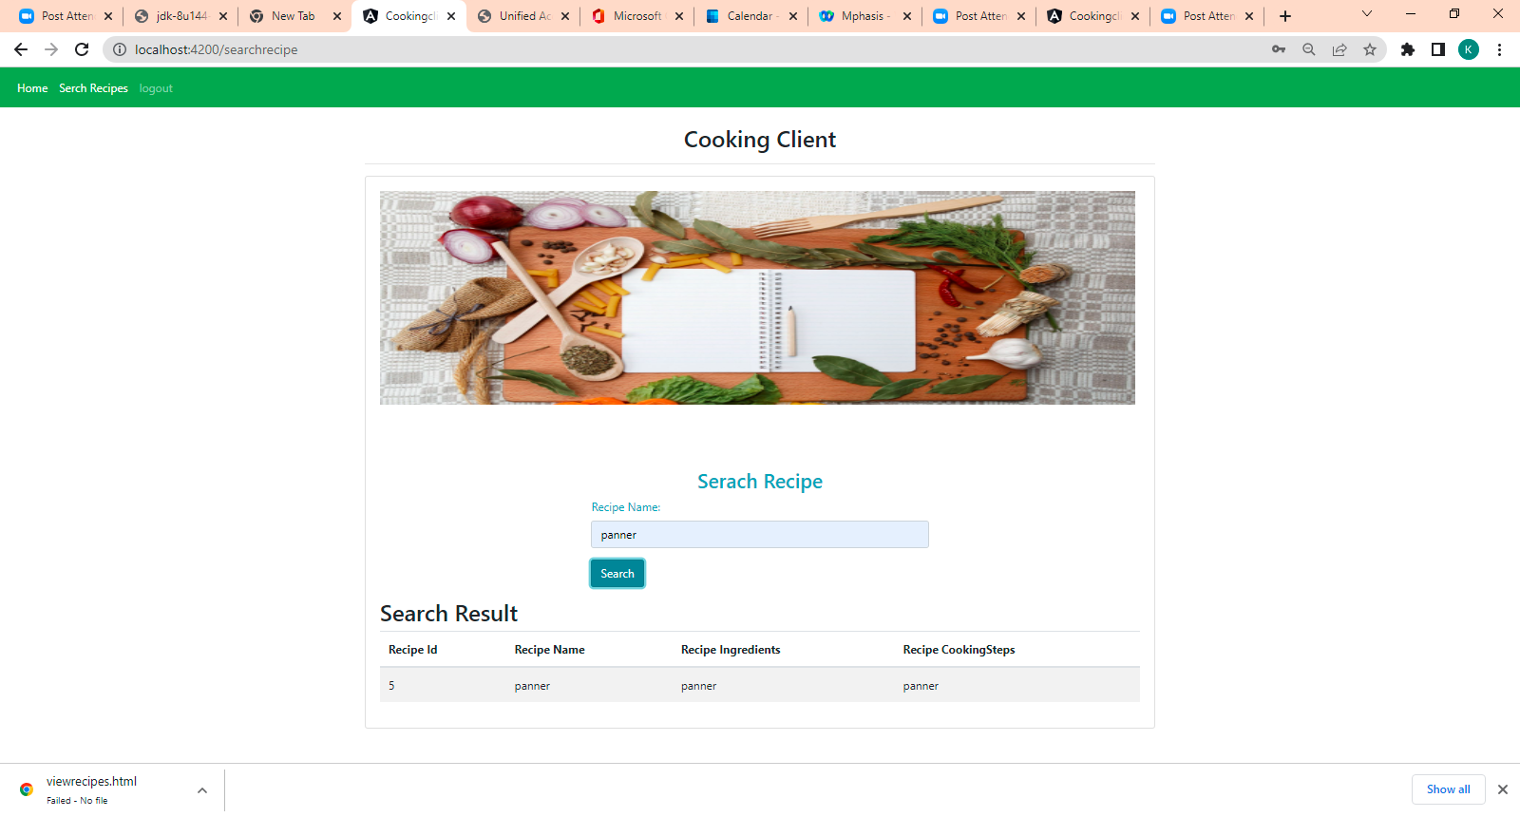
Search Recipe

Slide 10
Admin Module
Fields Required
Login
Create Admin Account
Add /Remove Recipe
Edit recipe details
Enable or disable Items

Slide 11
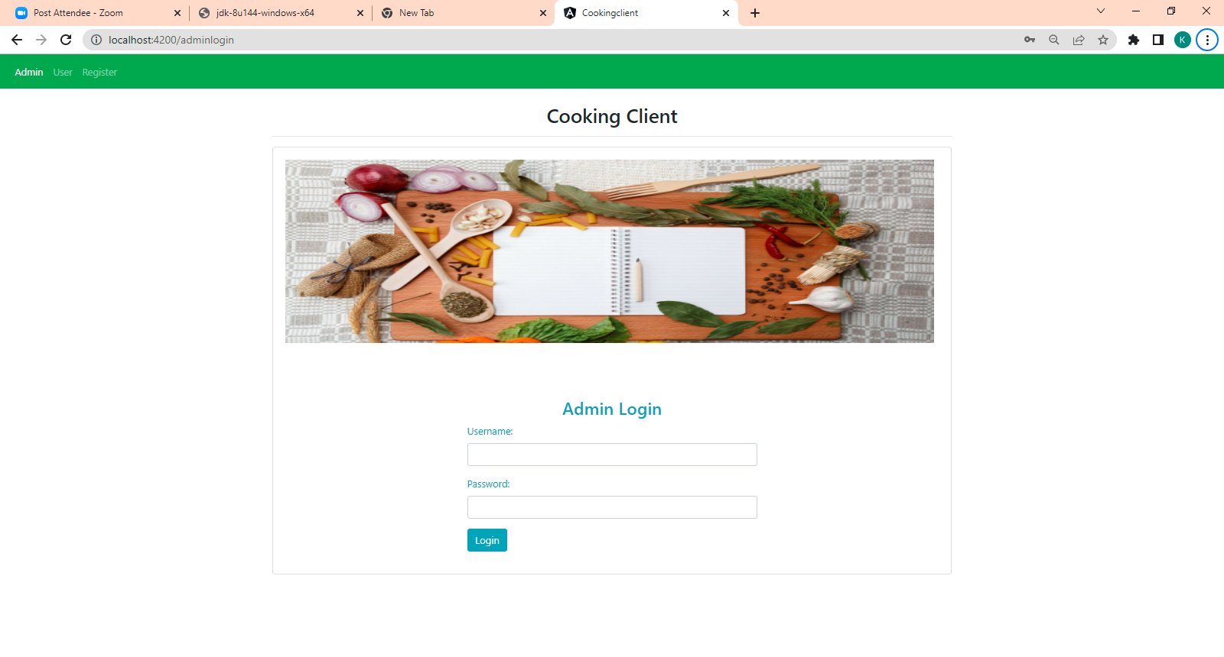
Admin Login

Slide 12
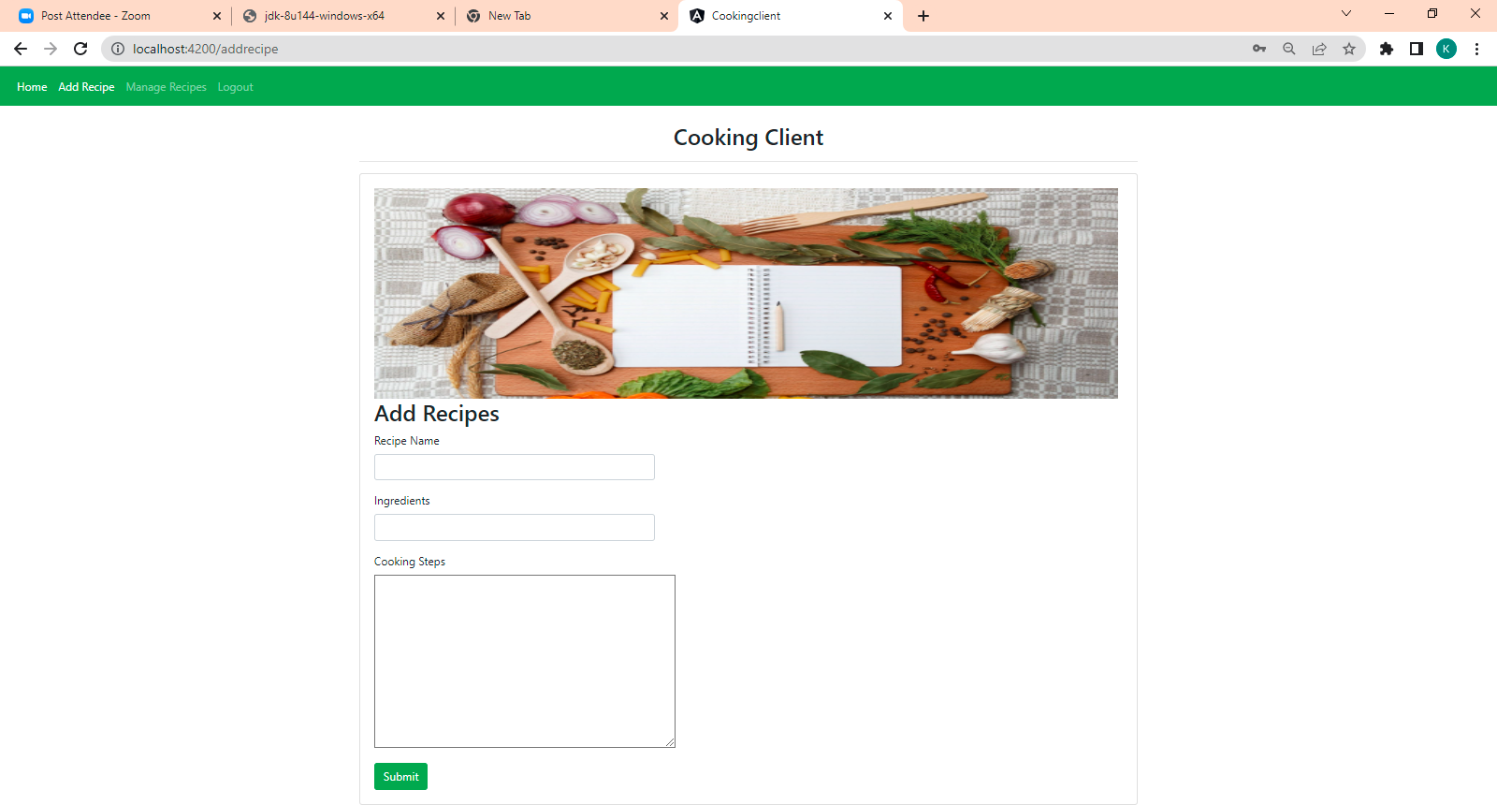
Add Recipe

Slide 13
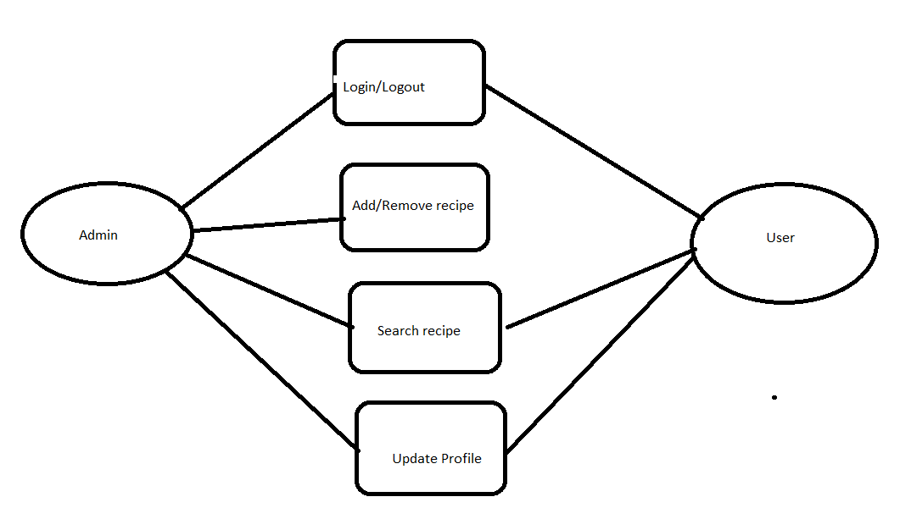
ER-Diagram

Slide 14
Advantages
Easy to use.
Easy to gather information about food items.

Slide 15
Future Scope
We can add new Recipes and add more search filters.

Slide 16
Conclusion
Created a website where user can register and login into the food recipe website.
User can be able to Search for recipes.
Admin can login and add recipes.

Slide 17
Presented by Group -4

